Slide 1
Jack Hibberd Head of Data & Marketing Liv-ex.com
Tuesday 28th February 2012
“The ‘fine’ Champagne market – increasing the fizz”
Harpers Champagne Summit

Slide 2
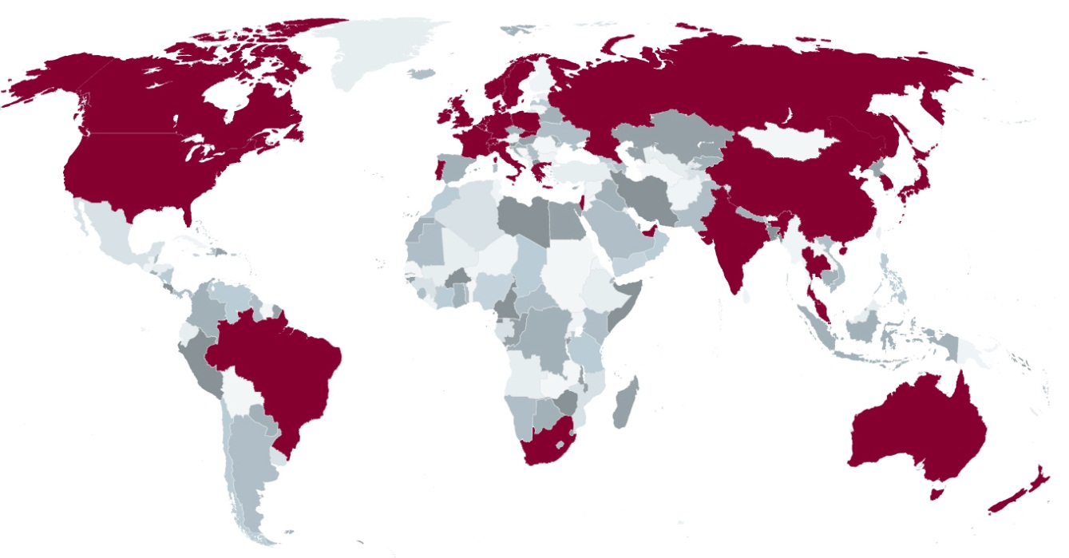
What is Liv-ex?
Established in 1999, Liv-ex is the global exchange for fine wine merchants:
More than £100m of wine was bought and sold on the platform in 2011
Sunday Times Fast Track 100 three times in the last five years
400+ members in 33 countries
Online marketplace
Price data, info and analysis
Storage & transport
Setter of standards

Slide 3
What is fine wine?
A wine with:
Secondary market trade
Ability to improve in bottle
Long track record
Critical acclaim
A recognised secondary market price and a liquid trading environment are the crucial factors.

Slide 4
The fine wine market
The fine wine market is worth US$4billion annually (up from US$1bn in 2004).

Slide 5
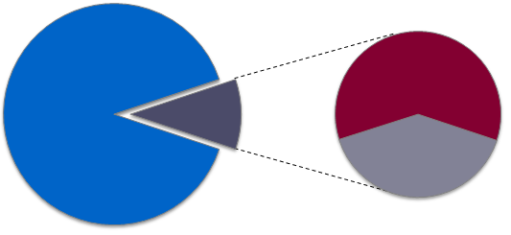
The fine wine market
Merchants account for 90% of trade.
New markets have led to strong growth.
US$3.6b
US$245m
US$408m
US$163m
Merchants
Auctions
Hong Kong
Other

Slide 6
“Fine” Champagne
Although Liv-ex traded 23 different Champagne brands last year, the vast majority of trade (90%+ by value) was in three key products:
Dom Perignon
Louis Roederer Cristal
Krug Vintage
Average bottle price in 2011 was £130. (In comparison, AC Nielsen off-trade average was £18 for NV and £23 for vintage.)

Slide 7
A declining share

Slide 8
“As for Champagne it’s [2.4%] percent of our business. In the good times of three years ago it made up 10% of our business.”
Stephen Browett, Farr Vintners
Harpers, 10th February, 2012
8

Slide 9
Yet, prices remain firm

Slide 10
Krug outperforms

Slide 11
Champagne v Bordeaux

Slide 12
An opportunity?
If not Bordeaux...
Collectors looking for something new?
A defensive stock for investors?
Asian opportunity?
Historically strong in the on-trade and retail, Champagne now has an opportunity to build sales amongst highly-involved private clients and wine investors.

Slide 13
Burgundy leads the way

Slide 14
Champagne to follow?

Slide 15
Exploiting the opportunity
Laissez-faire works
Release some control and get the market behind you. Exclusivity doesn’t mean scarcity.
Build a profile on the secondary market
Liv-ex, merchants and auctions can help build a fine wine brand.
Act like a fine wine, not a luxury brand
Leave something on the table for the consumer.

Slide 16
www.liv-ex.com

