Slide 1
Market Transparency and Efficiency: Fine Wine’s Online Revolution

Slide 2
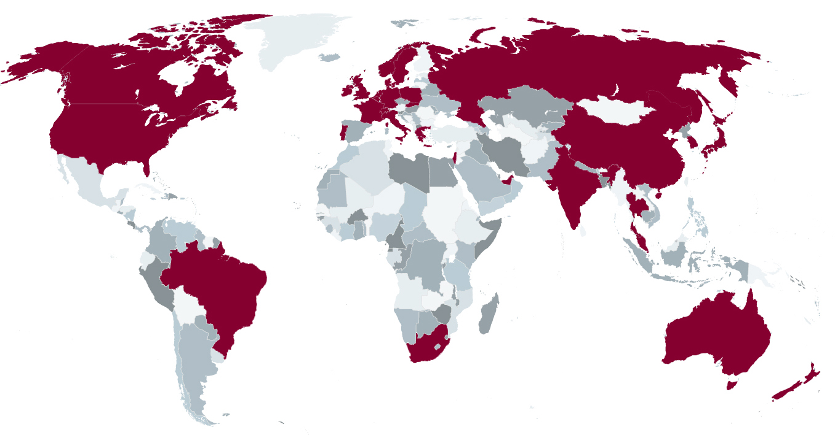
LIV-EX
Set up in 1999, the vision for Liv-ex was to create a global exchange for fine wine merchants.
400 members - 33 countries

Slide 3
RIPE FOR CHANGE
Traditionally opaque
Lack of trading liquidity
Highly fragmented, both in terms of players and products

Slide 4
MARKET TRANSPARENCY
The internet’s most important innovation has been transparency of:
Quality
Availability
Pricing

Slide 5
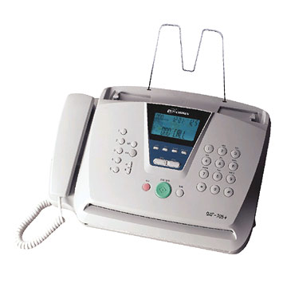
MARKET TRANSPARENCY
Ten years ago, price discovery was time consuming and imperfect - even for insiders. Outsiders had no chance.

Slide 6
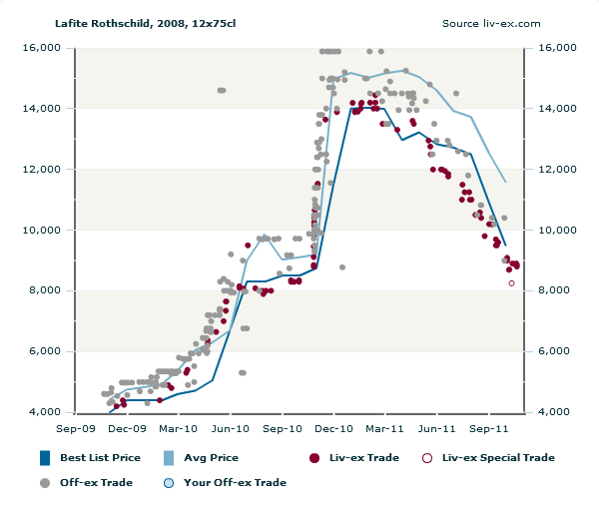
MARKET TRANSPARENCY
Today, price discovery is instant and available to all:

Slide 7
THE RESULT
Dramatically lower barriers to entry
Increased confidence for both the trade and collectors
Margin compression, but market expansion

Slide 8
MARKET EXPANSION
Global fine wine turnover has quadrupled since 2004, reaching USD4bn in 2010.

Slide 9
HIGHER PRICES
Prices for the top wines have increase 220% in ten years.

Slide 10
WHAT NEXT?
In our view, the next ten years will be all about using the internet to increase efficiency, reduce costs and limit stock movement.
The focus will move from improving the trading experience, to improving post-trade settlement.

Slide 11
A POST-TRADE REVOLUTION
Two key issues:
Accounting and logistics functions in fine wine remain little changed in 20 years.
Fine wine continues to use commercial wine’s logistics infrastructure, despite having very different requirements. The internet gives the fine wine trade the opportunity to develop its own platform.

Slide 12
IMPROVING SYSTEMS
Increased data interchange between customers and suppliers using industry-wide messaging standards.
Transactions, invoices, warehouse instructions and accounts entries will be electronic– allowing for straight-through processing.
L-WIN – The Universal Wine Code – is a key part of this process. A common language for the trade: one wine, one code.

Slide 13
A NEW SUPPLY CHAIN
From a business perspective - commercial wine and fine wine have nothing in common....
So why do they share the same supply chain?

Slide 14
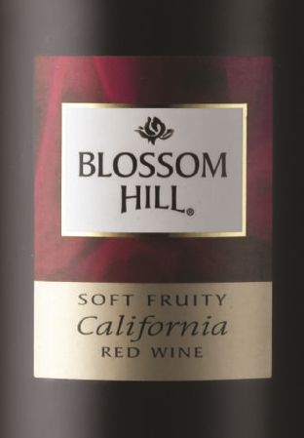
COMMERCIAL WINE
Producer
Distributor
Consumer
Fast moving: Designed to be drunk within eighteen months of release.
Low value: The average bottle price in the UK (before tax and retailer margin) was $2 in 2010.
Short and Simple: Direct supply chain.

Slide 15
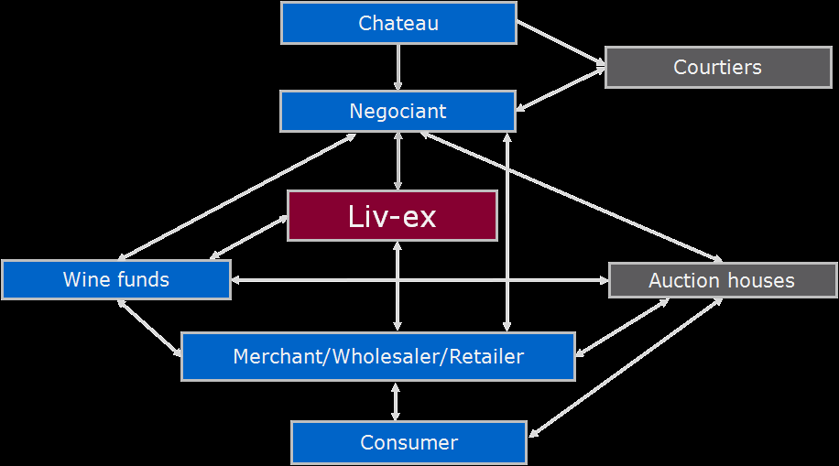
FINE WINE
Slow moving: Designed to mature for up to 50 years.
High value: The average traded price for a bottle of wine on Liv-ex in 2010 was $400.
Long and Complex: Complicated supply chain.

Slide 16
ELIMINATE MOVEMENTS
80% of the trade on Liv-ex is in wines from the last ten vintages, the majority of which are not for immediate consumption.
So why move it?
Eliminating excessive movement of stock offers huge upside.

Slide 17
THE SOLUTION
We are reorganising our logistics along central depository lines, which is:
A mechanism for storing and managing ownership records in multiple locations.
Ownership can be transferred via electronic transfer, removing the need for physical movements.

Slide 18
THE BENEFITS
Reduced costs and risk
Faster working capital cycle time
Better provenance

Slide 19
TO CONCLUDE
The revolution in transparency is well advanced, but the potential gains from reorganising the post-trade infrastructure could be even more important.
Visit our mobile site – www.liv-exHKIWSF.com – to download this talk or find us on

